Slide 2




Minimal API marries DDD
Alberto Acerbis
alberto.acerbis@intre.it

Slide 3
What are Minimal API
var builder = WebApplication.CreateBuilder(args);
var app = builder.Build();
app.MapGet("/", () => "Hello World!");
app.Run();
No API is ever that simple!

Slide 4
I have already seen this code
var express = require('express');
var app = express();
app.get('/', function(req, res) {
res.send('hello world');
});

Slide 5
Once upon a time
WebApplication
│ appsettings.json
│ Program.cs
│ Startup.cs
│ WebApplication.csproj
│
├───Controllers
│ Controller.cs

Slide 6
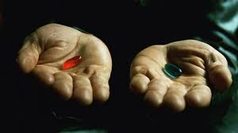
Minimal vs MVC
How deep is the white rabbit hole?

Slide 7
Why Minimal?
Minimum set of components to build HTTP APIs
Performance is a benefit ... but not the benefit
Good for Cloud
All in a single file ... joy or sorrow?
They do not replace MVC!

Slide 8
Minimal != Simple
No support for content negotation. Just JSON
No native support for API versioning
No support for validation
But we have FluentValidation
No enforcement about project structure
and that is good!

Slide 9
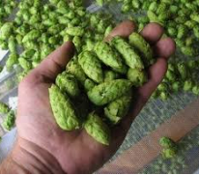

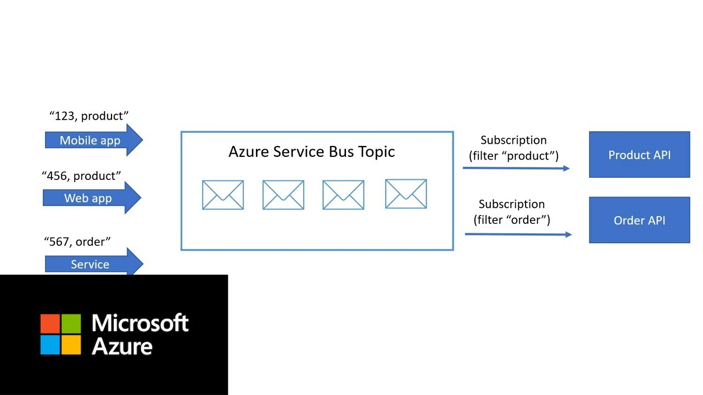

We Like to Brew Beer
Suppliers
Production
Pubs

Slide 10
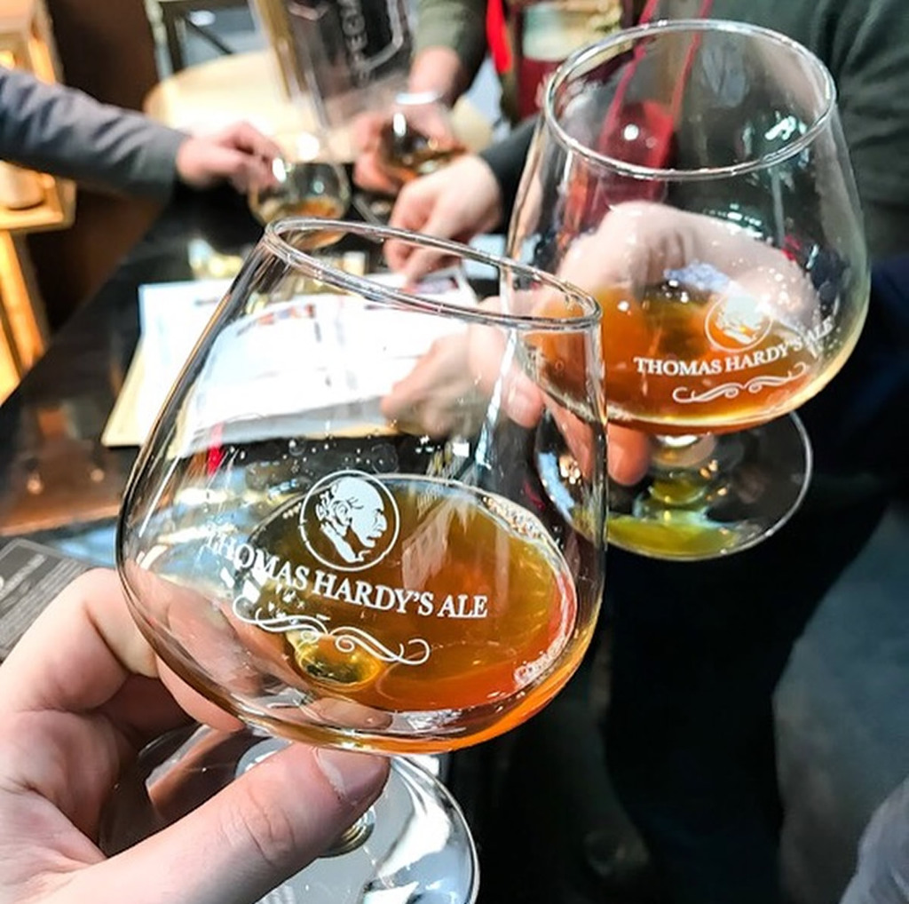
Talk is Cheap … Show me the code
@Linus Torvalds

Slide 11
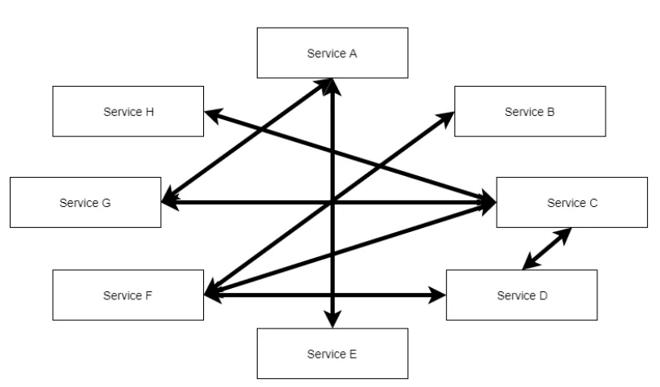
The Big Ball of Mud
The problem is not «The Big Ball» … the problem is «Mud»

Slide 12
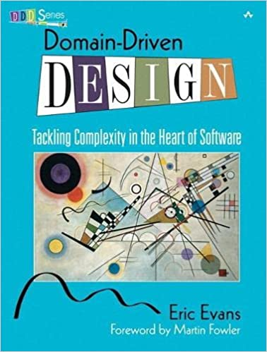
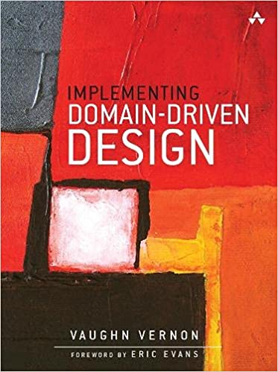
DDD – The Silver Bullet?

Slide 13
Sphere of Knowledge
Within a contextual boundary of expertise, the terms, meanings, and business rules used by single responsible team working in that area form a special team language. This language is ubiquitous inside the boundary because it is regualarly used orally by the team, written in documents and drawn in diagrams, and the source code of the software model reflects the language.
Strategic monoliths and microservices (V. Vernon)

Slide 14
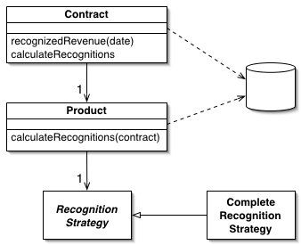
Domain Model
An object model of the domain that incorporates both behavior and data
Domain Model (martinfowler.com)

Slide 15
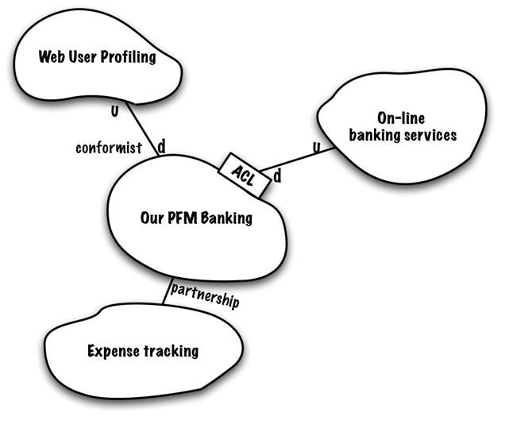
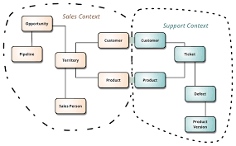
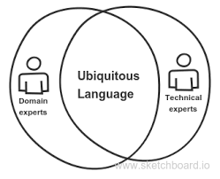
DDD – Strategic Patterns
Context Mapping
Bounded Context
Ubiquitous Language
https://www.infoq.com/articles/ddd-contextmapping/
https://martinfowler.com/bliki/BoundedContext.html
https://blog.carbonfive.com/ubiquitous-language-the-joy-of-naming/

Slide 16
Talk is Cheap … Show me the code
@Linus Torvalds

Slide 17
Microservices … What?

Slide 18
Microservice & Bounded Context
Feature | Bouded Context | Microservice | Compatibility
Organized around Business Capabilities | È implicitamente inteso nel concetto stesso di Ubiquitous Language, che è il pattern principale per identificare un Bounded Context | Teams Cross-Funzionali specifici per una funzionalità di business | Perfetta!
Decentralized Governance | Un modello condiviso per ogni scopo | Vengono favorite/incentivate le scelte locali, che devono essere indipendenti. | Perfetta!
Decentralized Data Management | La persistenza privata è fondamentale per la consistenza del linguaggio, ma soprattutto necessaria per l’evoluzione sicura e indipendente del modello | Ogni microservizio deve persistere i propri dati in un database privato! Pena l’impossibilità di evolvere autonomamente dagli altri | Perfetta!
Evolutionary Design | Ogni modello può, e deve, evolvere indipendente dagli altri | E’ una key feature | Perfetta!
Smart endpoints and dumb pipes | Raccomandato come modello strategico | Key feature. SOA docet! | Fattibile
Language Consistency | Ubiquitous Language! Obbligatorio! | Implicito e raccomandato | Nessun problema
Componentization via Services | Context Map | Key feature | Nessun problema
Products not Projects | Raccomandato per la conoscenza approfondita del modello | Key feature | Nessun problema
Design for Failure | DDD incentiva l’evoluzione continua | Key feature | Nessun problema

Slide 19
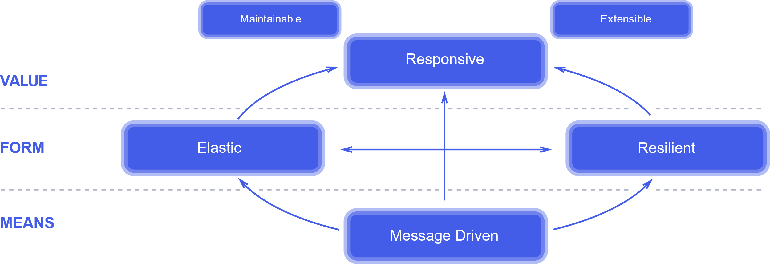
The Reactive Manifesto
Jones Boner, Dave Farley, Roland Kuhn, Martin Thompson – 16.01.2014
The absolute, most important thing is it to be responsive. This means that a reactive system needs to remain responsive event when a failure occurs.

Slide 20
Code CleanUp
Review the project structure
Using modules
Automatic loading
Ability to remove and add without starting from scratch

Slide 21
Talk is Cheap … Show me the code
@Linus Torvalds

Slide 23



Minimal API marries DDD
Alberto Acerbis
alberto.acerbis@intre.it
@aacerbis
LinkedIn
https://github.com/brewup
https://github.com/Ace68/GlobalAzure2022
https://github.com/cqrs-muflone

